Slide 1

Ngày 25 tháng 7 năm 2022
Introduction Server
Technologies and
Management Services
Presented by: Bùi Hương Linh
Class: GCH1006
Student ID: GBH200662
Tutor: Dzung Lai Manh

Slide 2

Table of Content
Ngày 25 tháng 7 năm 2022
1
Identify the purpose and types of DNS, including explanations on how domain names are
organised and managed.
2
Explain the purpose of
Communication protocols
Server hardware
Operating systems
Web server software
Explain the relationship between technologies above with regards to designing,
1
publishing and accessing a website.
3 Discuss the capabilities and relationships between front-end and back-end website
technologies. Explain how these relate to presentation and application layers
4
Areview of different website technologies supported with the tools and sofware used to develop
websites
Frond-end technologies
Back-end technologies
Databases
IDEs
CMS
Website builders

Slide 3

1. Indentify the purpose and types of DNS, including
explanations on how domain names are organized and
managed.
So, in order to better understand how a website works, we must first
understand the website components, including the tools/means used to make
it work.

Slide 4

Introduction to WWW & History of the World Wide Web
What is Word Wide Web?
The World Wide Web, also known as a
Web, is a collection of websites or web
pages stored in web servers and linked to
local computers via the internet. Web
pages formatted in HTML and linked by
links called "hypertext" or hyperlinks and
accessed via HTTP are the building blocks
of the Web.

Slide 5

Introduction to WWW & History of the World Wide Web
History of Web
Tim Berners-Lee, a British scientist,
created the World Wide Web (WWW)
while working at CERN in 1989. The Web
was created to meet the demand for
automated information sharing among
scientists in universities and institutes
around the world.

Slide 6
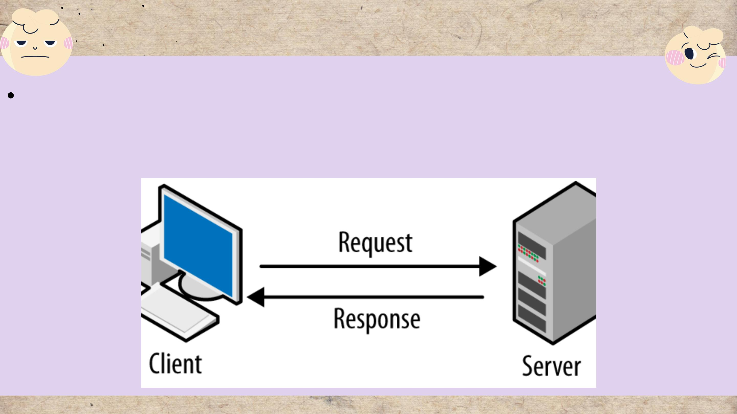
How the Web works
Clients and server
Clients are the internet-connected devices of the average web user (for example,
your computer connected to your Wi-Fi or your phone connected to your mobile
network)

Slide 7
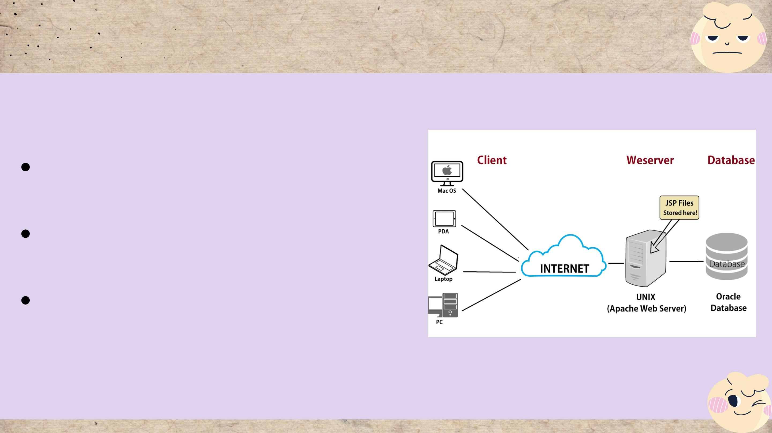
How the Web works
Web server
A place to store source code and
website content.
The web server is identified by its
IP address.
Websites often use a small
portion of the web server's
resources.

Slide 8
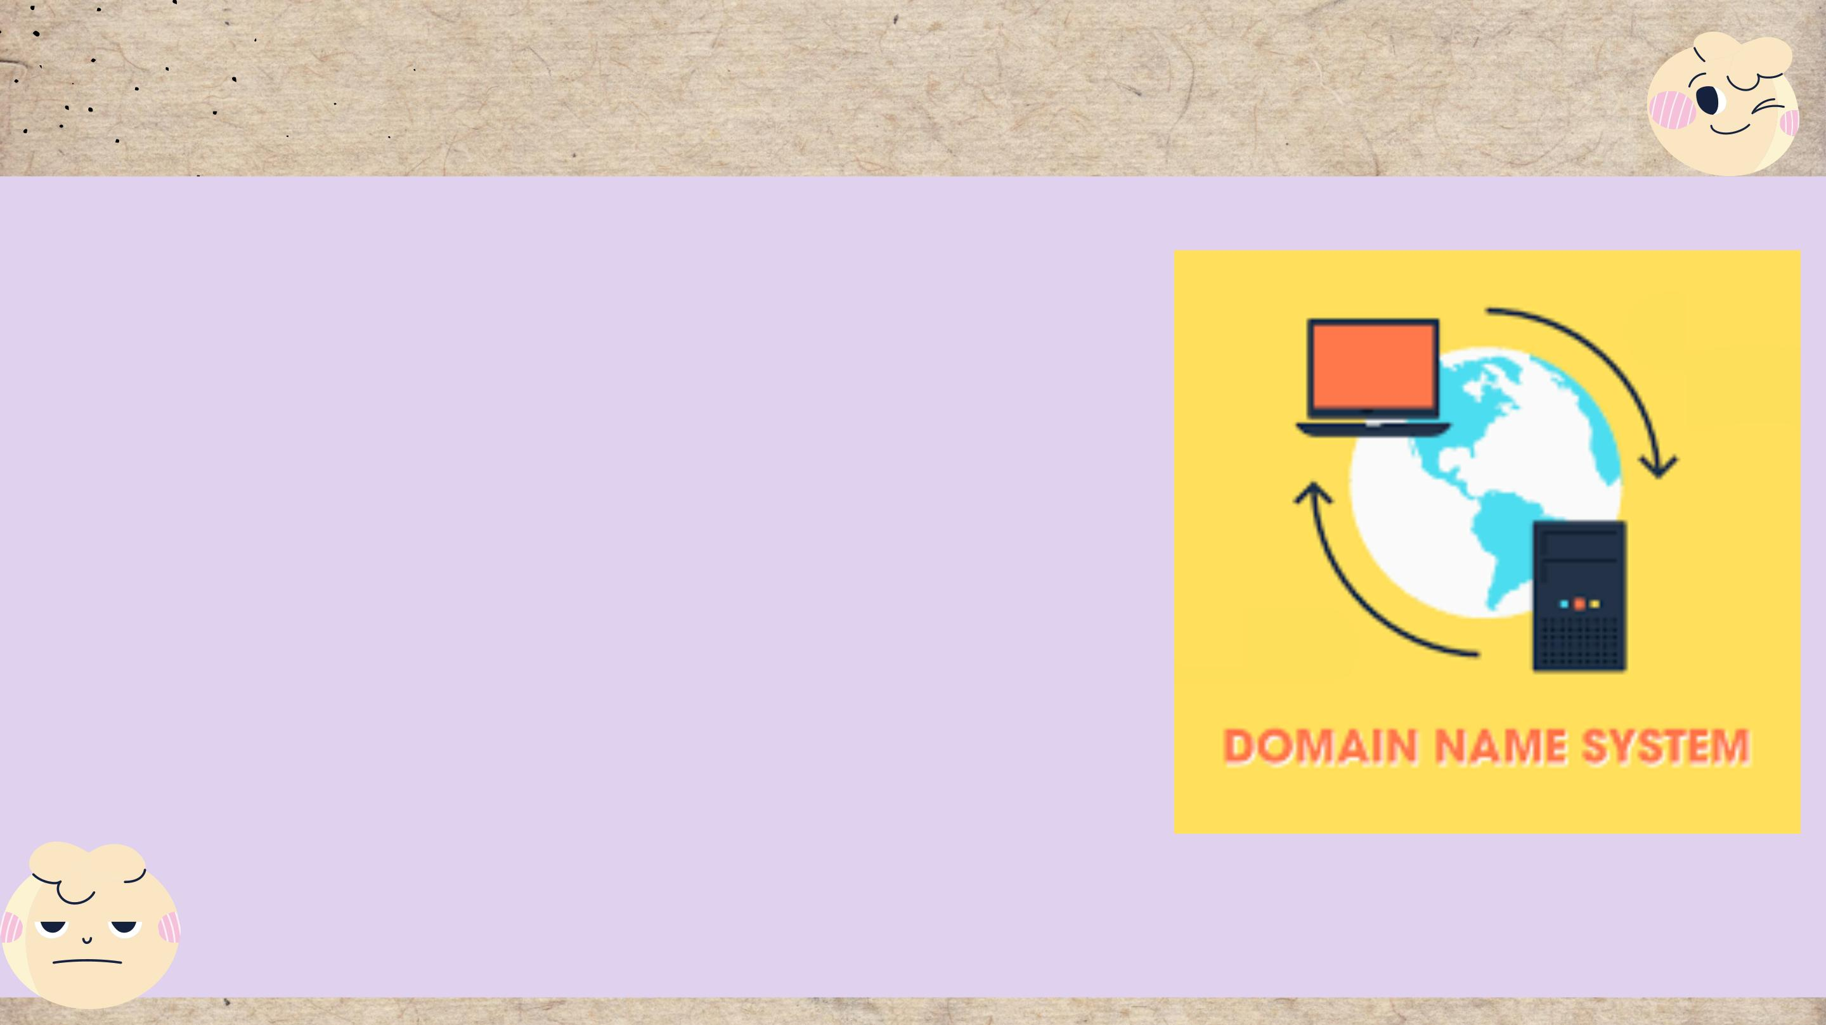
Domain name system (DNS)
The Domain Name System (DNS) is a collection of
databases that convert hostnames to IP addresses.
DNS is known as the internet's phone book because
it convertNavigating the internet would be difficult
without DNS (especially search engines like Google),
because we'd have to enter the IP address of each
website we wanted to visit.

Slide 9
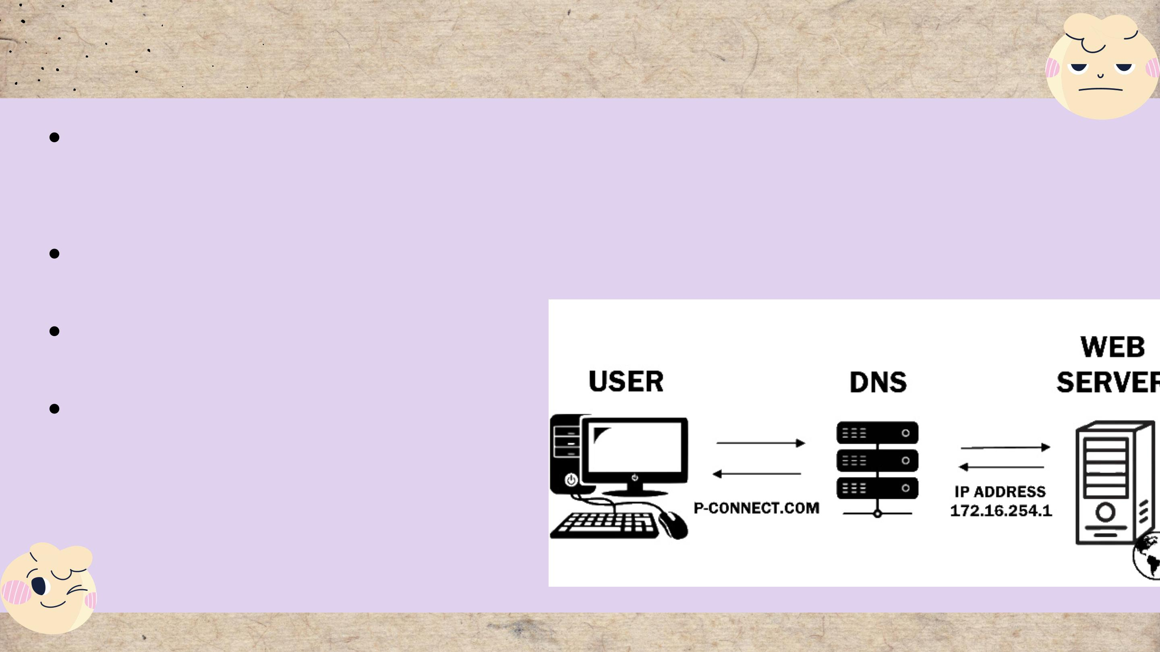
Purpose of DNS
DNS's primary function is to provide mapping
between symbolic names and IP addresses in a global
hierarchical and hierarchical database.
Converts human readable domain name intro
Internet
Protocol (IP) addresses and vice versa.
Protocol (IP) addresses and vice versa
A list of names that correspond to
numbers.

Slide 10
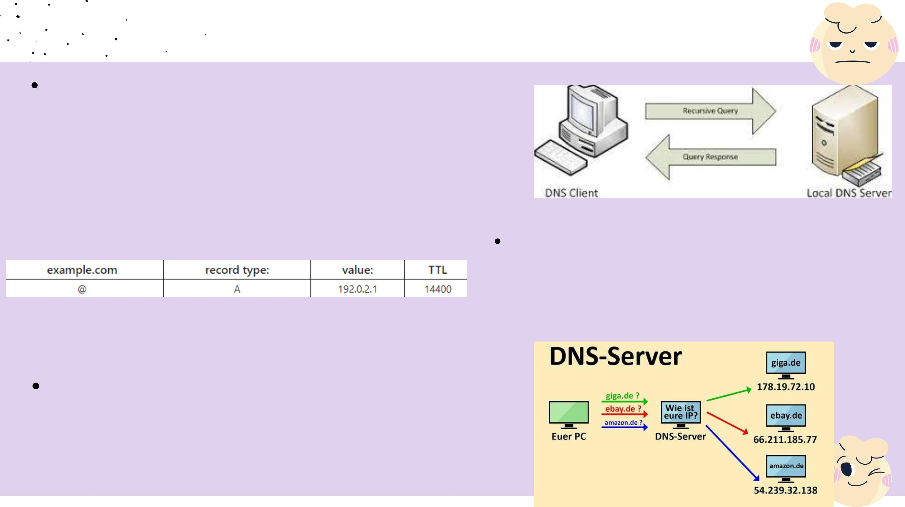
Types of DNS
DNS queries
DNS query is also known as a DNS request. So, it is a request for
information that is sent from the user’s computer to ask for the IP
address to a DNS server. This means the DNS client is querying the
DNS server to get the IP address, related to that domain.
Record
A DNS record was created by the DNS server to
provide important information about the domain or
hostname as well as its current IP address.
DNS Servers
DNS servers are responsible for converting domain names
into IP addresses. It takes human requests and converts
them into machine IP addresses, making it easier to reach
the origin server DNS

Slide 11

2. Explain the purpose of
Communication protocols
Server hardware
Operating systems
Web server software
Explain the relationship between
technologies above with regards to
designing, publishing and accessing a
website.

Slide 12
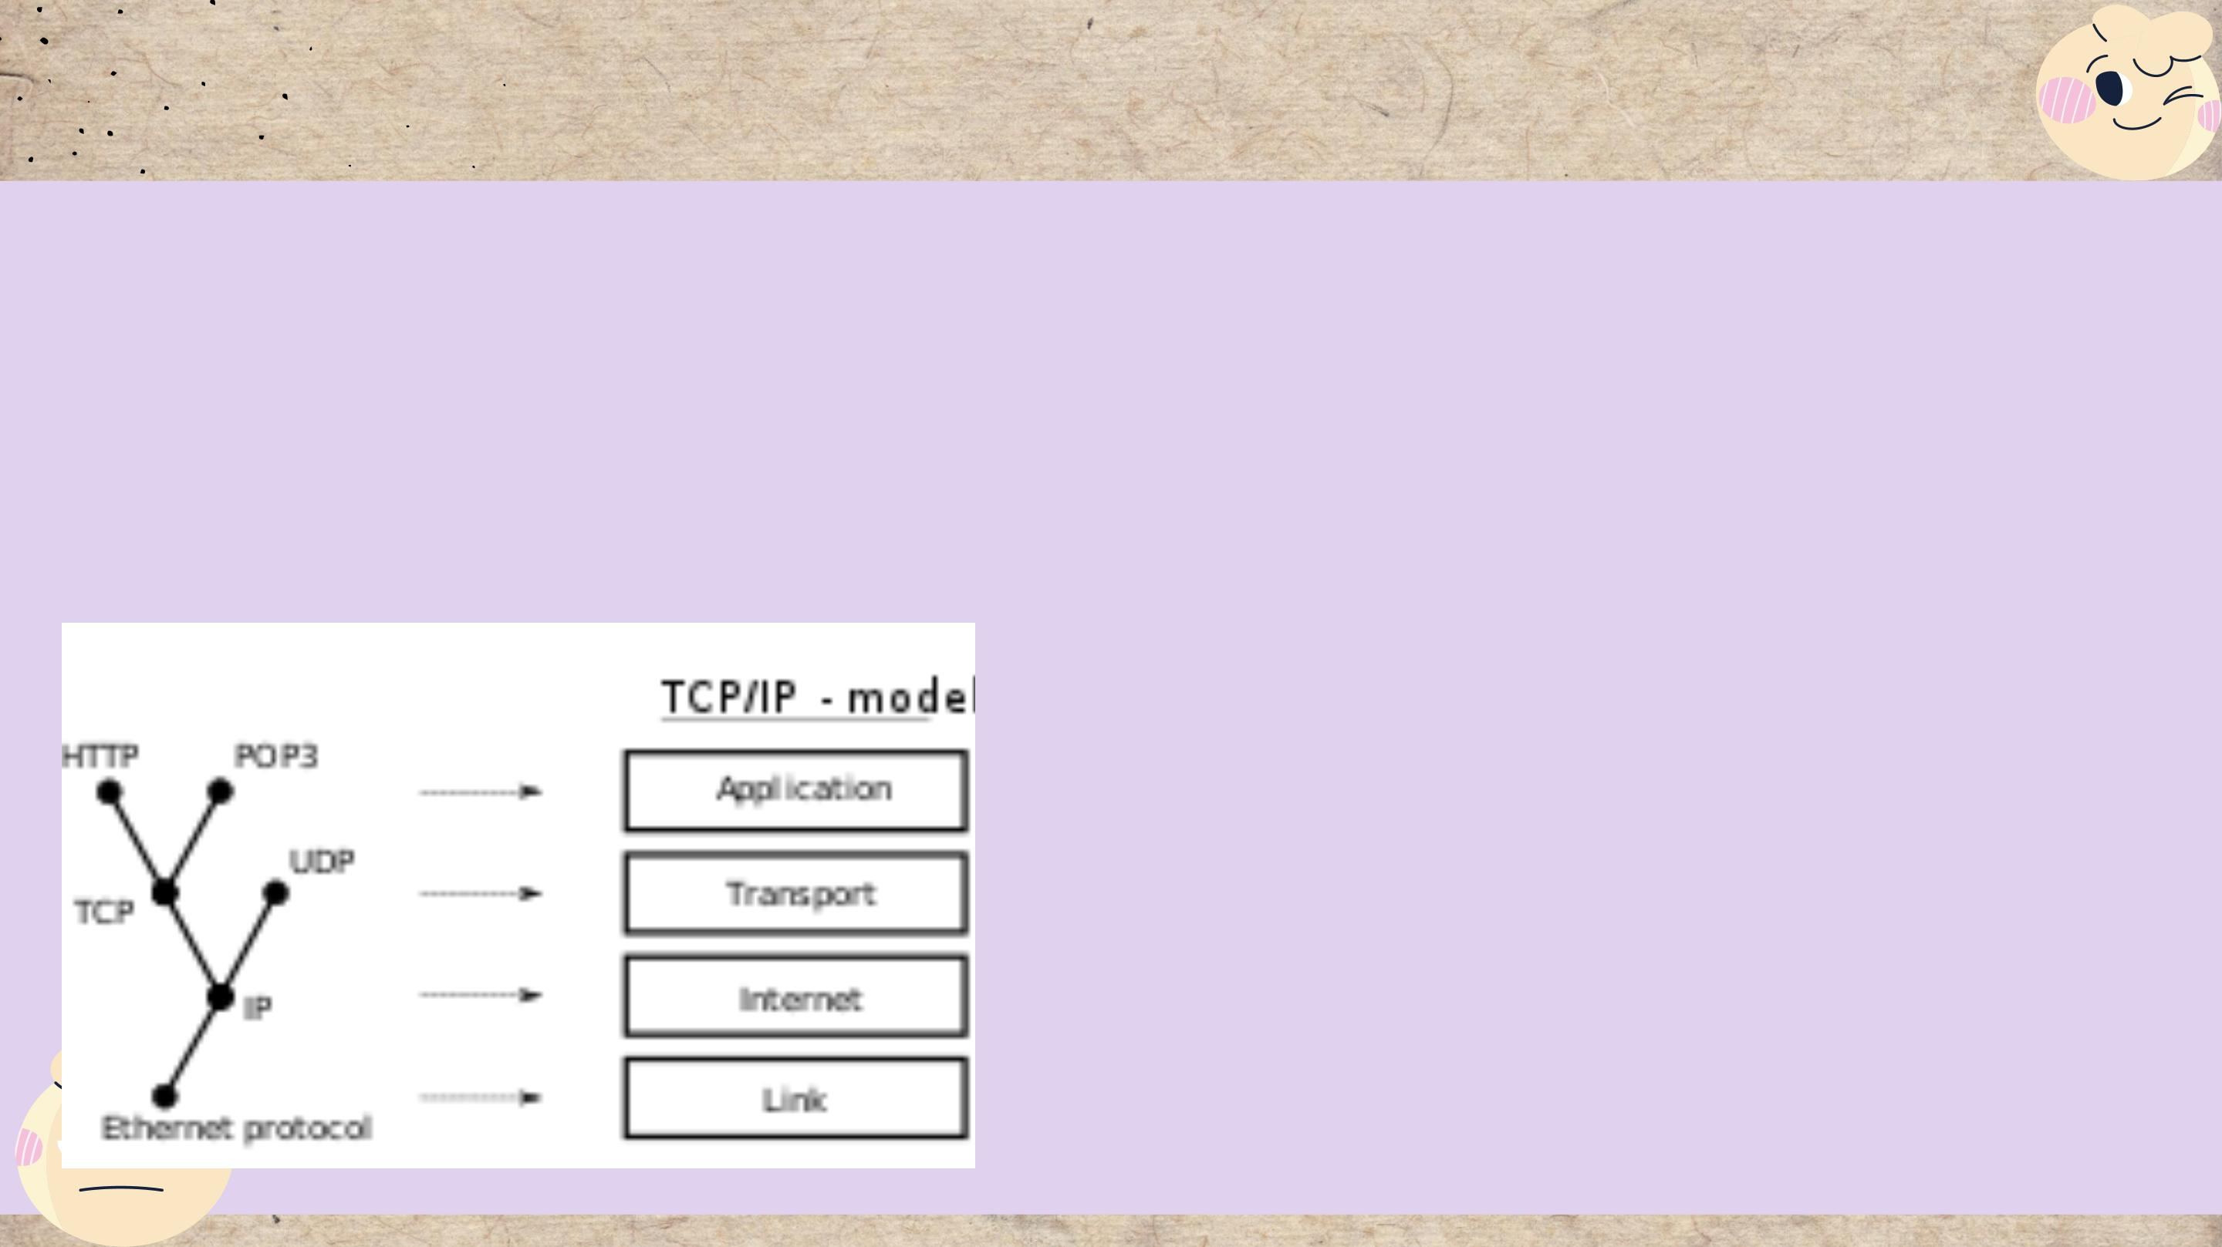
Communication protocols
What does Communication protocols?
Protocols for communication are formal descriptions
of digital message formats and rules. They must
exchange messages within or between computing
systems.
Protocols for communication can cover
authentication, error detection and correction,
and signaling. They are also capable of
describing the syntax, semantics, and
synchronization of analog and digital
communications.

Slide 13
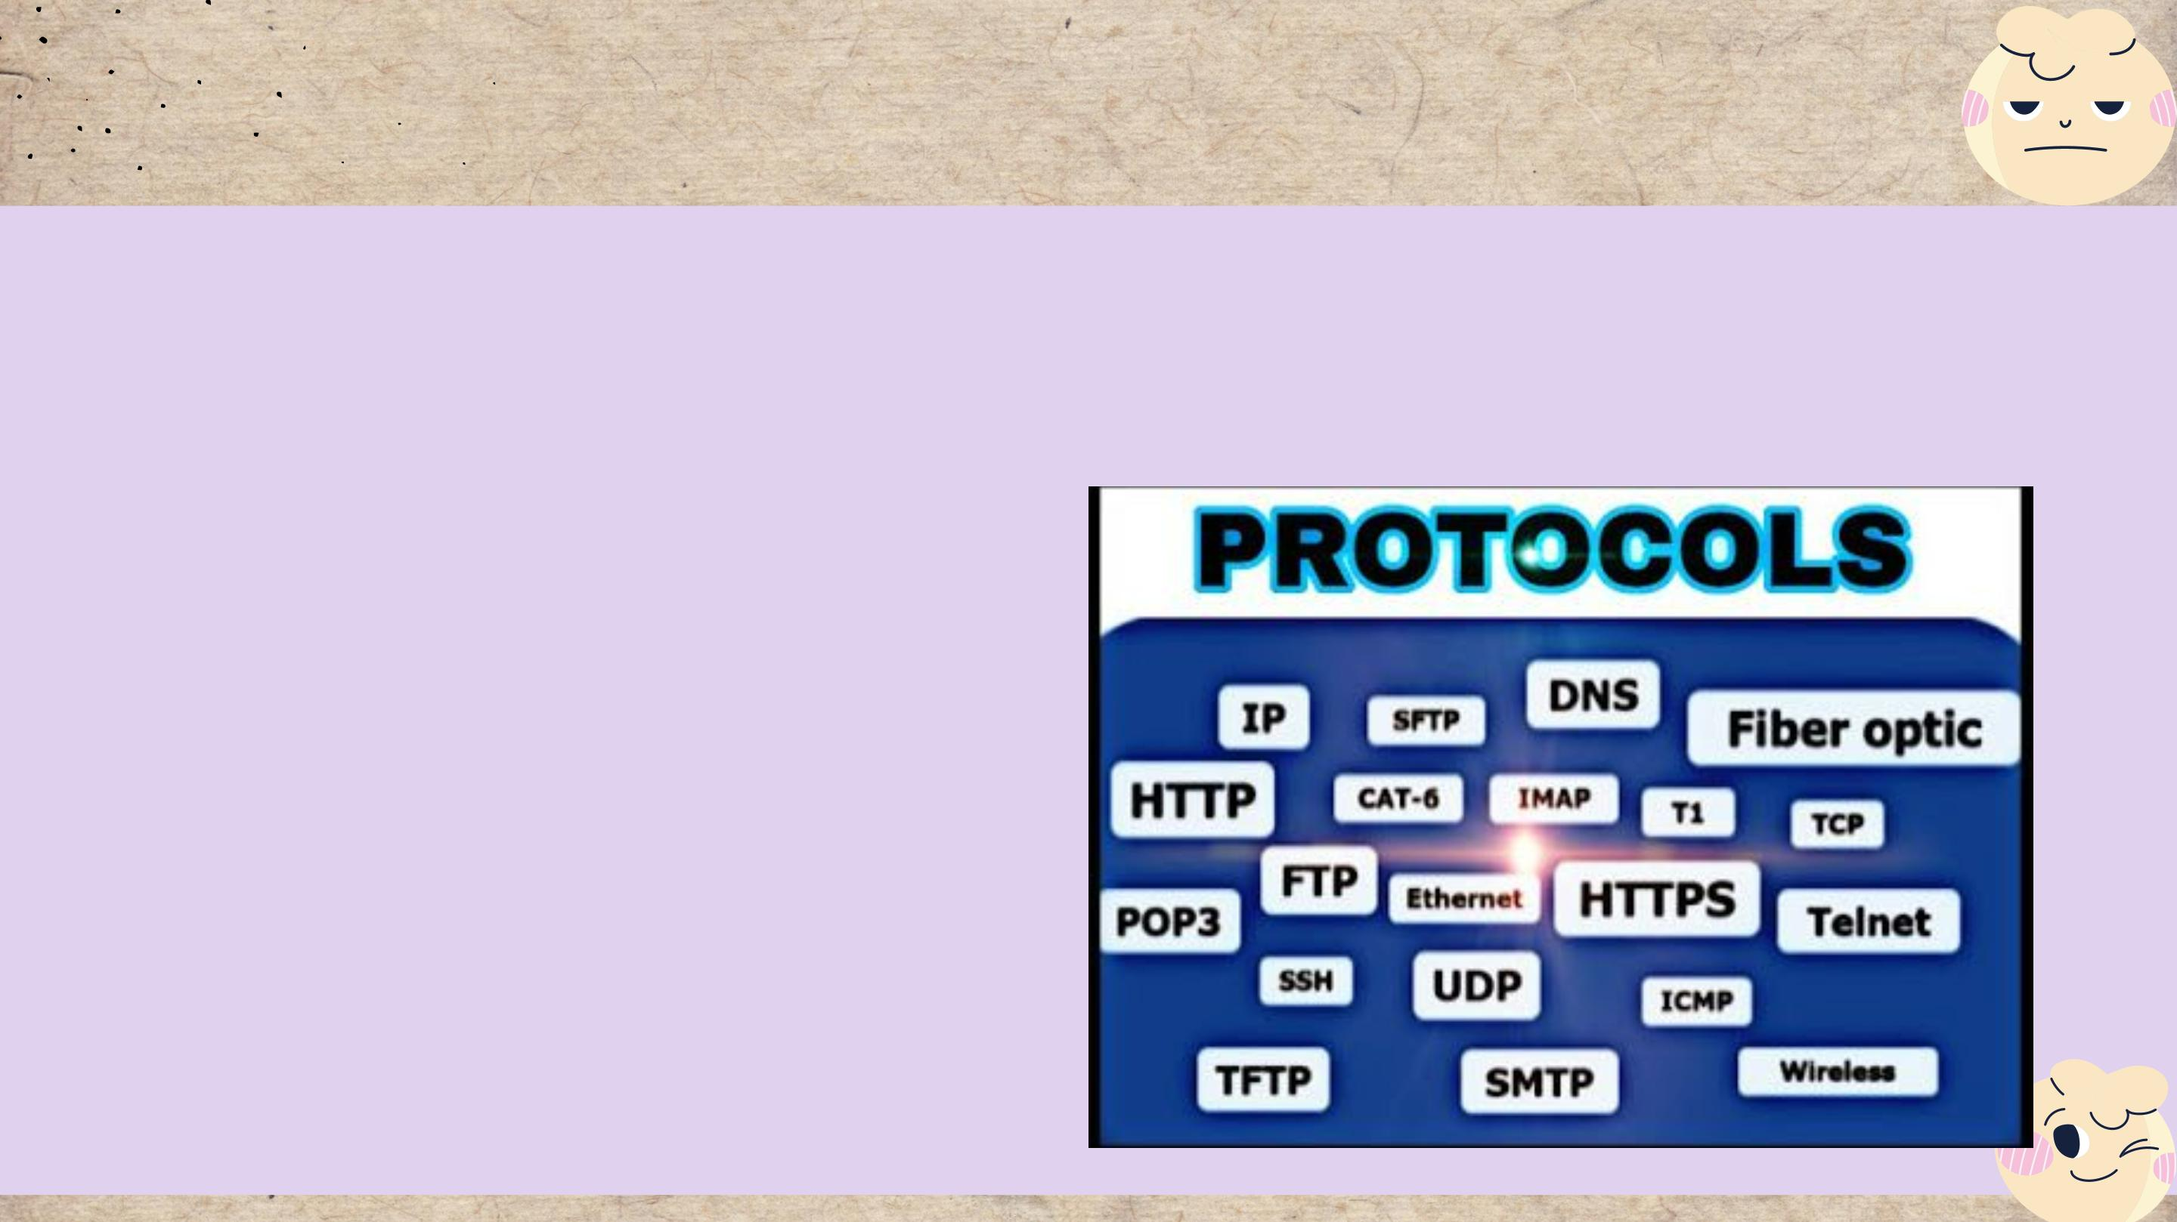
Communication protocols
Types of protocols
Before successful transmission can occur, networked communications devices must agree on many
physical aspects of the data to be exchanged. "Protocols" are rules that define data transmissions.
A protocol can define a wide range of transmission properties.
Protocols may address the following properties,
for example:
• Packet size.
• Transmission speed.
• Error correction types.
• Routing.
• Address formatting.

Slide 14
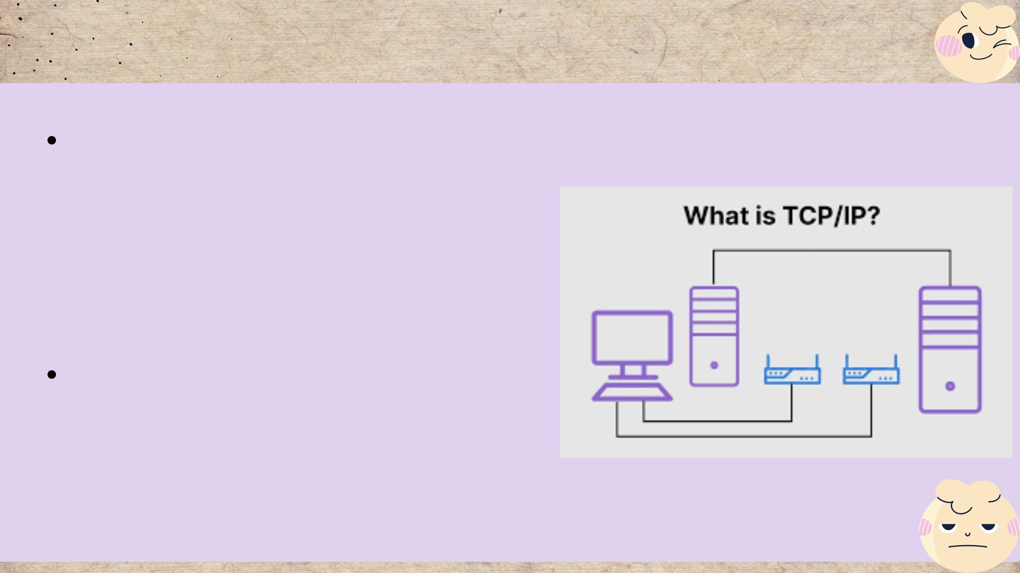
Communication protocols
Transmission Control Protocols (TCP)
TCP is an abbreviation for Transmission
Control Protocol, a communications protocol
that allows application programs and
computing devices to exchange messages
across a network.
TCP is a popular communication protocol
that is used for network communication. It
divides any message into a series of packets
that are sent from source to destination,
where they are reassembled.

Slide 15
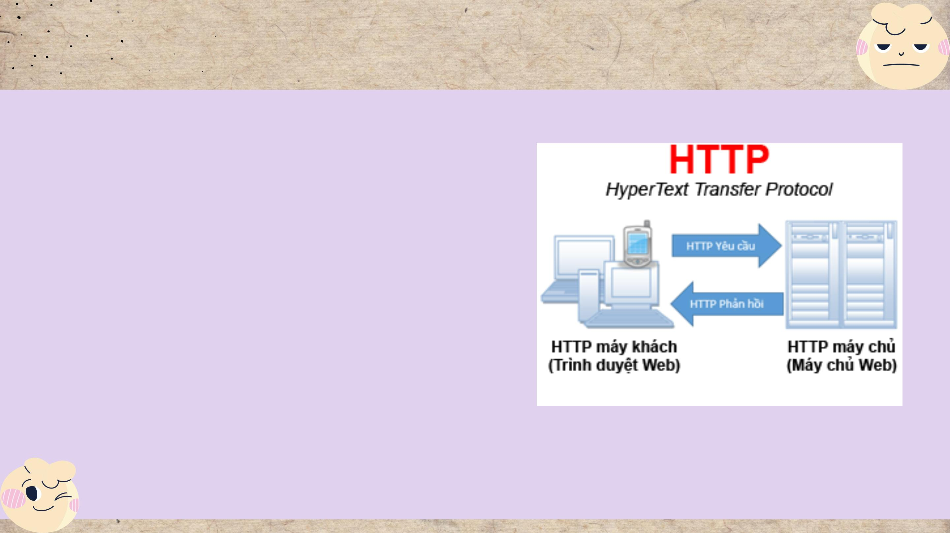
Communication protocols
Hypertext Transfer protocols
(HTTP) is an application-layer protocol that is
used to transmit hypermedia documents such as
HTML. It was created to facilitate communication
between web browsers and web servers, but it
can also be used for other purposes. HTTP is a
stateless protocol, which means that the server
does not store any data (state) between requests.

Slide 16

Server hardware
Server Hardware is defined as computer
hardware that operates in a local area network
and runs administrative software that controls
access to all or part of the network and its
resources and makes such resources available
to computers acting as network workstations.
• A computer with a large data memory
• Organize, retrieve, and transmit computer files
and data.
• Complete tasks to keep the workflow running
smoothly and productivity high.

Slide 17
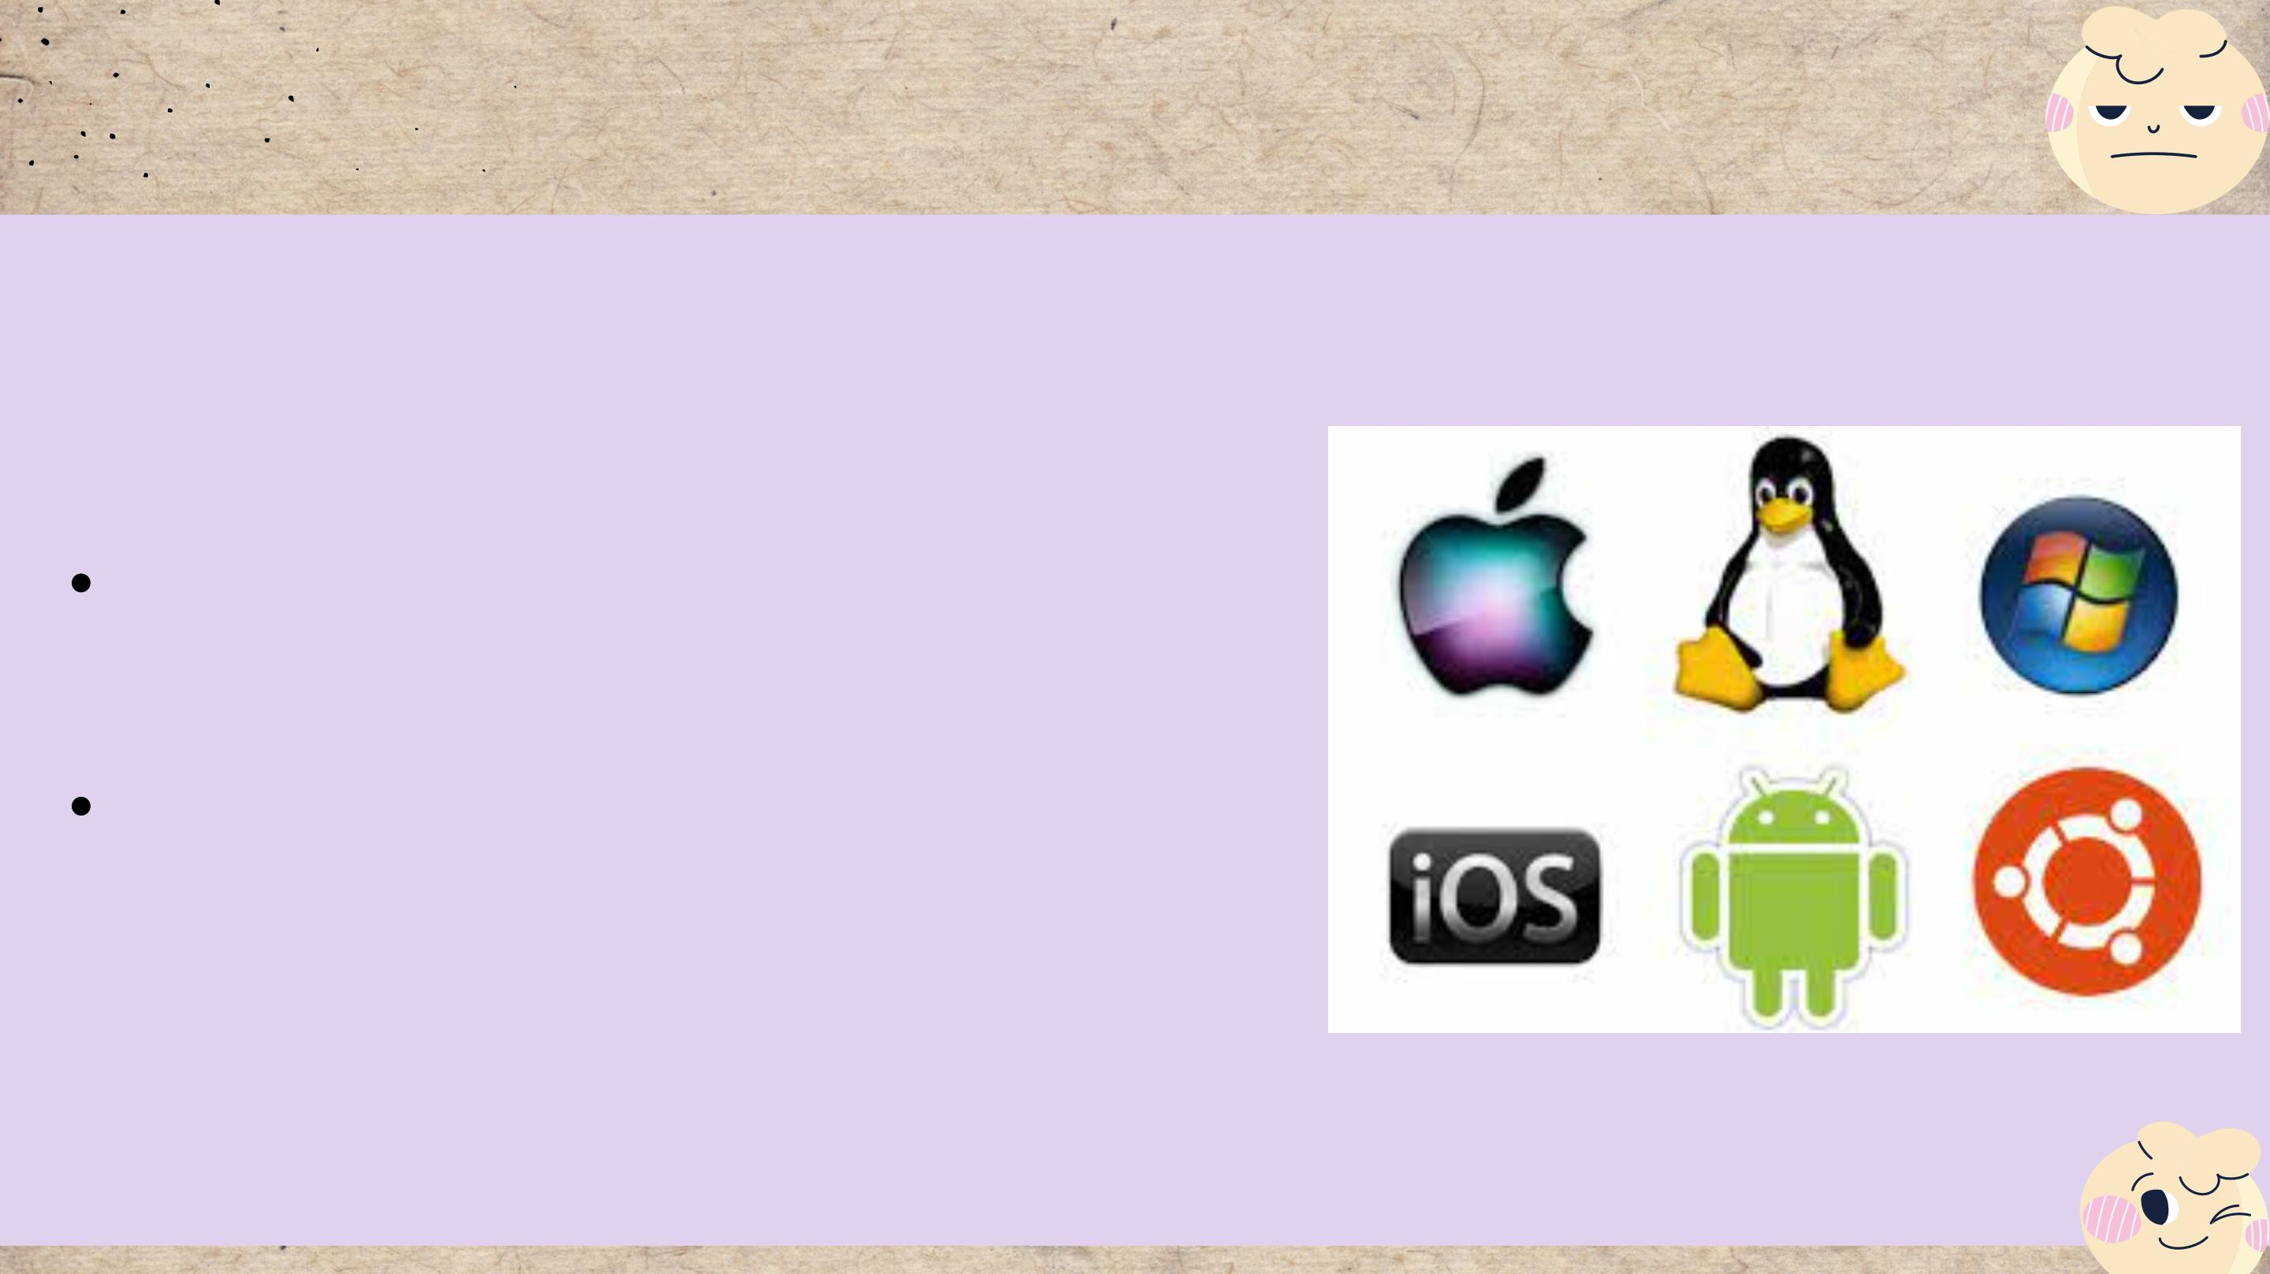
Operating systems
An operating system is simply a type of software
that serves as a bridge between computer
hardware and the end user. A computer requires
an operating system in order to function.
An operating system's functions
An operating system provides various types of
services to an application.
Benefits of an Operating System
There are numerous benefits to using an
operating system. The operating system also
provides easy-to-use resources to the user, acting
as an intermediary between the hardware and
software systems.

Slide 18

Web Server Sofware
Server software is software that is intended to
be used, operated, and managed on a
computer server.
Alternatively, a server computer may be used
to make files and programs available to other
computers.
• Prevent SQL injections, XSS, and CSRF
attacks.
• With proper documentation and examples,
the configuration is simple to learn.
• A lightweight server that is ideal for older
hardware and embedded systems • The best
Unix web server with secure and advanced
features.

Slide 19
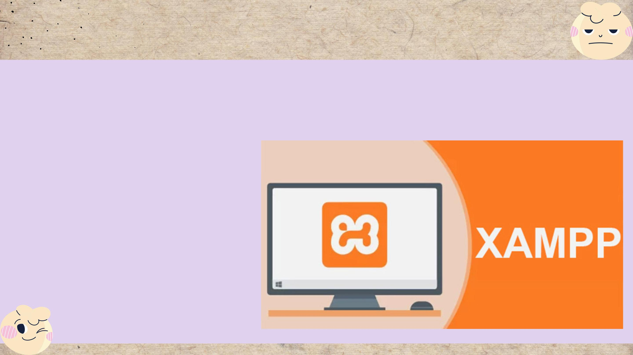
Web server
XAMPP
XAMPP is a simple Apache distribution that
includes MySQL, PHP, and Perl. XAMPP is
extremely simple to install and use – simply
download, extract, and begin.

Slide 20
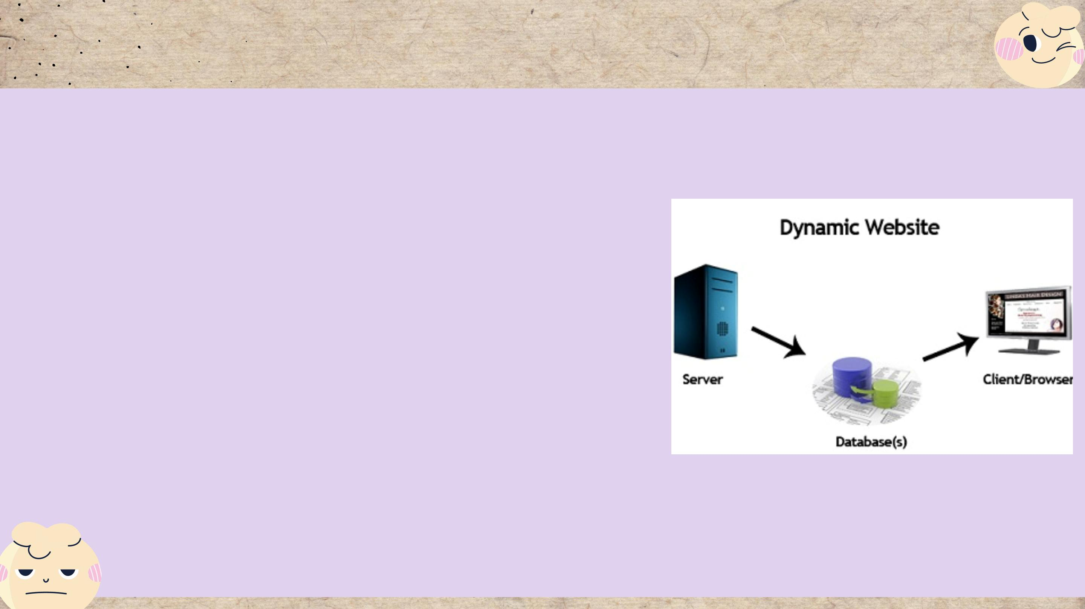
3. Discuss the capabilities and relationships between front-end
and back-end website technologies.
Dynamic Web Server
It is also a static web server that has been enhanced with the help
of an application server or databases. When a client sends a
request, the application server modifies or updates the hosted file
before delivering it to the client via HTTP server.
Advantages
• Much more functionality
• Easy to update
• Always a fresh site the brings in new visitors or/and prospective
customers
• A system that provides for unique collaboration of the admin.,
staff and the visitors/users
Disadvantages
• More expensive
• Require time for development
• Higher hosting costs

Slide 21
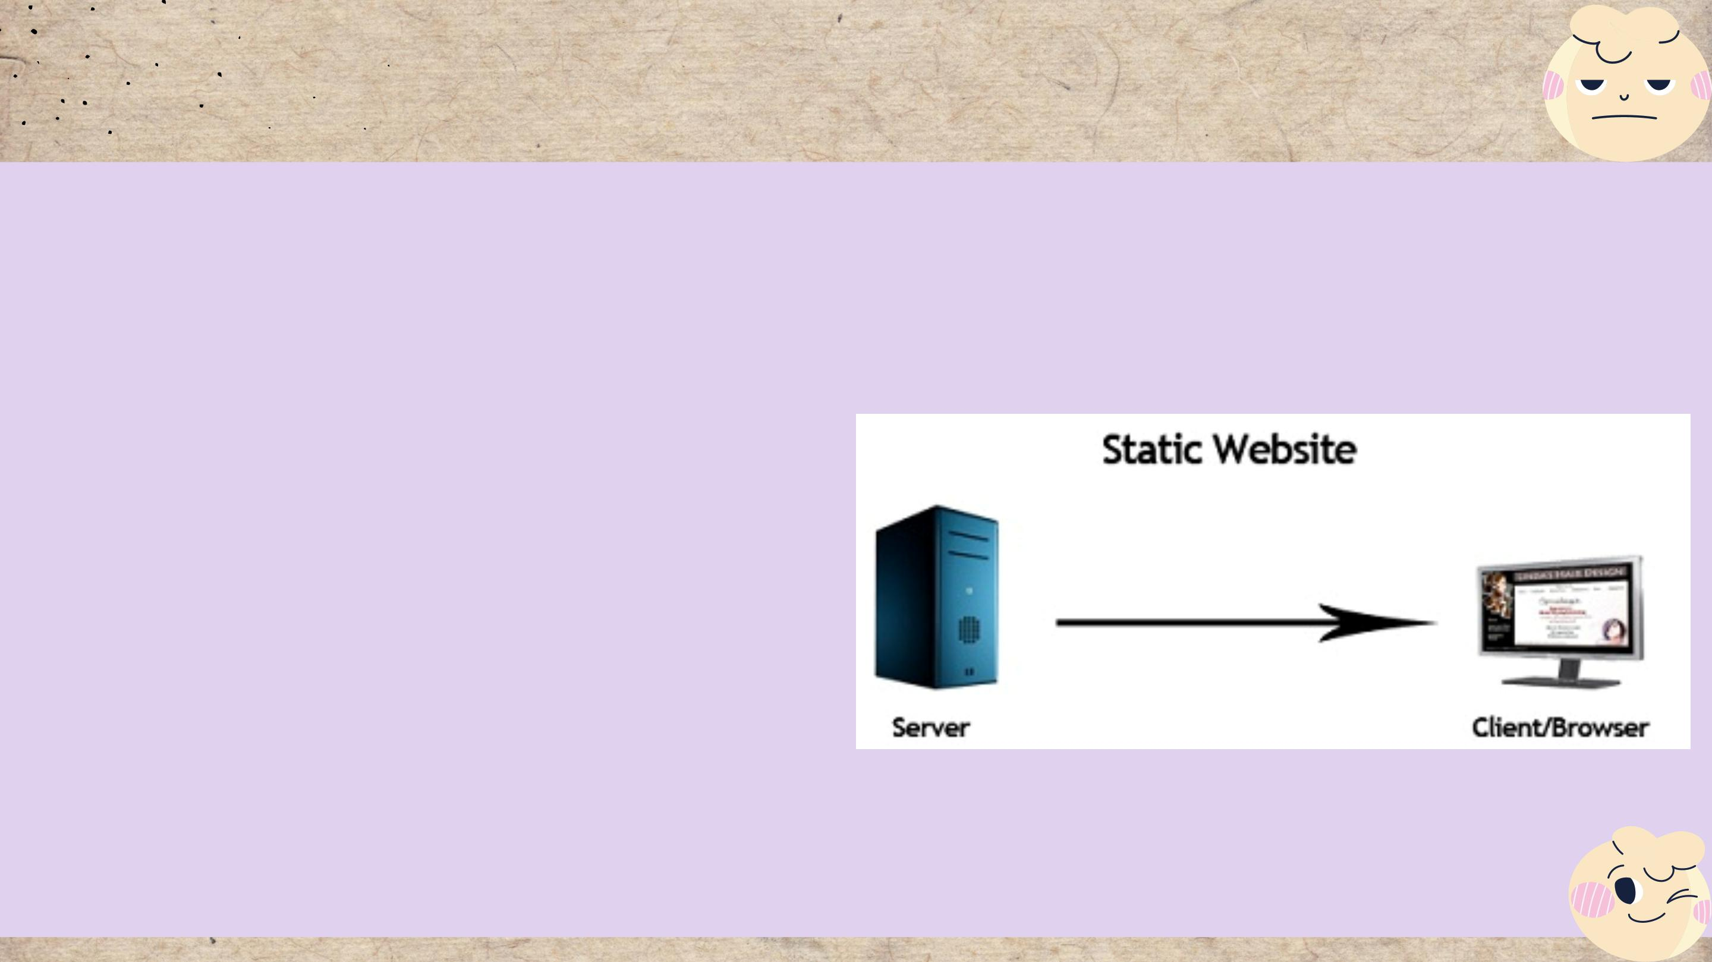
3. Discuss the capabilities and relationships between front-end
and back-end website technologies.
Static Web Server
It is built on the foundation of a physical server
(hardware) and an HTTP server (software). When
a client uses his browser to request a specific
file, the static web server sends the hosted files
in their entirety.
Advantages
• Are relatively easy to develop
• Are less expensive to develop
• Are also relatively inexpensive to host.
Disadvantages
• A good web-development expertise is required for updating
static web-pages
• The site may not be very useful for visitors and users
• The site may suffer from content stagnation.

Slide 22

3. Discuss the capabilities and relationships between front-end and
back-end website technologies.
Front-end
Front-end development is an important aspect of web
development that you should be familiar with. Front-end A
developer is someone who creates interfaces based on design
patterns.
• Proficient in programming languages such as HTML, CSS, and
Javascript.
• Web design that is mobile-friendly.
• SEM (Search Engine Marketing) (SEO).
• AJAX and asynchronous request handling
• Issues with cross-browser compatibility and workarounds
• Testing from start to finish with a headless browser.
• A one-page application.

Slide 23

3. Discuss the capabilities and relationships between front-end and
back-end website technologies.
Back-end
In contrast to Front-end, the work of a Back-end
Developer is usually not visible to the outside world
because they frequently manipulate the server and
data.
• Programming languages such as Node.js, PHP,
Python, Ruby, or Perl.
• Language-specific Automated Testing Frameworks
• Information transformation.
• Access to Application Data
• Concerns about security, authentication, and
authorization.

Slide 24
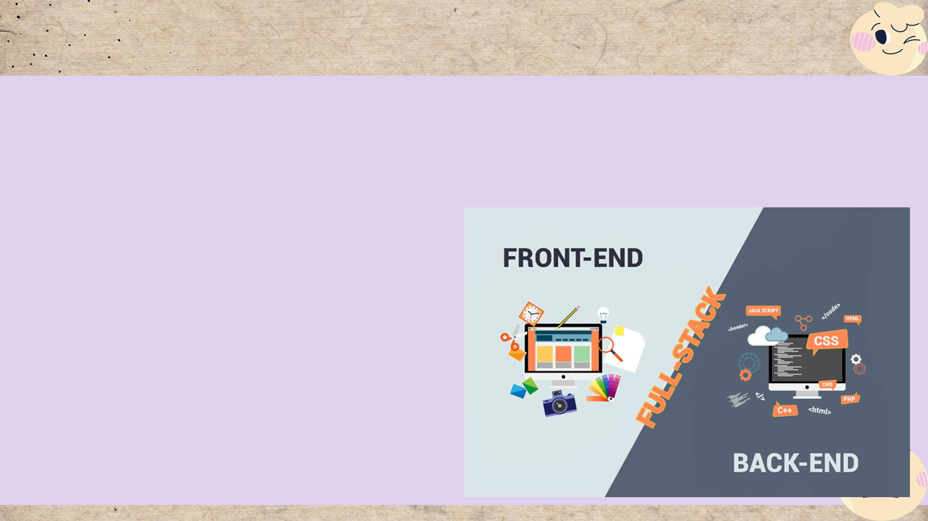
Relationships between front-end & back-end website technologies
Front-End and Back-End refer to the separation
of concerns between the presentation layer,
application layer, and database layer, as well as
the application layer in front-end and two
layers in back-end, namely application and
database layer.
Three different layers of front-end and back
end include:
• Presentation Layer
• Application layer
• Database Layer

Slide 25

4. A review of different website technologies supported with the tools
& software used to develop website
Frond-end technologies
Back-end technologies
Databases
IDEs
CMS
Website builders

Slide 26
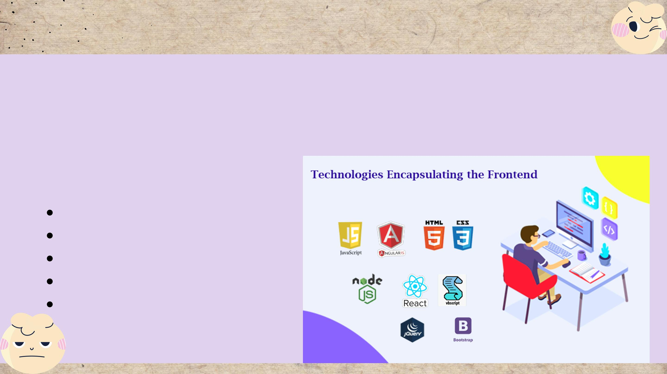
Front-end technologies
To be known as a front-end developer, you
must first master some fundamental skills.
Some of these require you to be an expert.
Then there are the desirable abilities.
Front-end languages:
HTML
CSS
Java scrip
J query
ReactJS

Slide 27
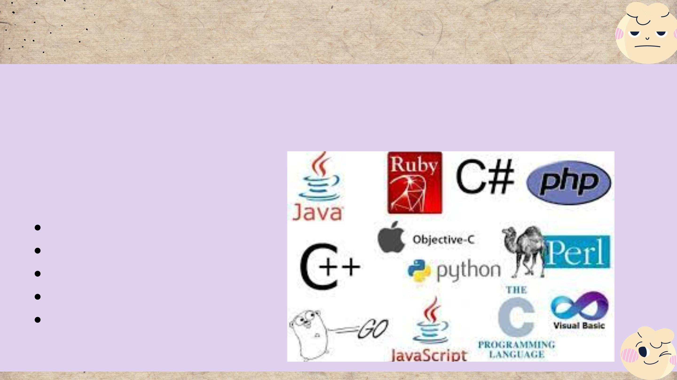
Back-end technologies
Back-end technologies, such as languages,
must be dealt with by programmers or back-
end developers in order to handle the back
end of given applications.
Back-end languages:
Java
PHP
Python
SQL
ASP.NET

Slide 28
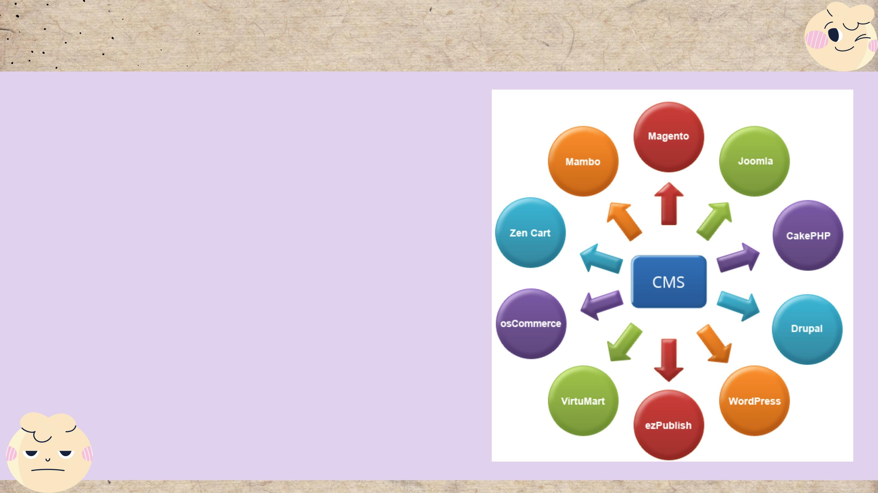
CMS technologies
When you hear the word CMS, you
immediately think of content
management systems, don't you?
And now I'll introduce you to the
three most popular content
management systems:
• CMS WordPress
• CMS Joomla
• CMS Magento

Slide 29
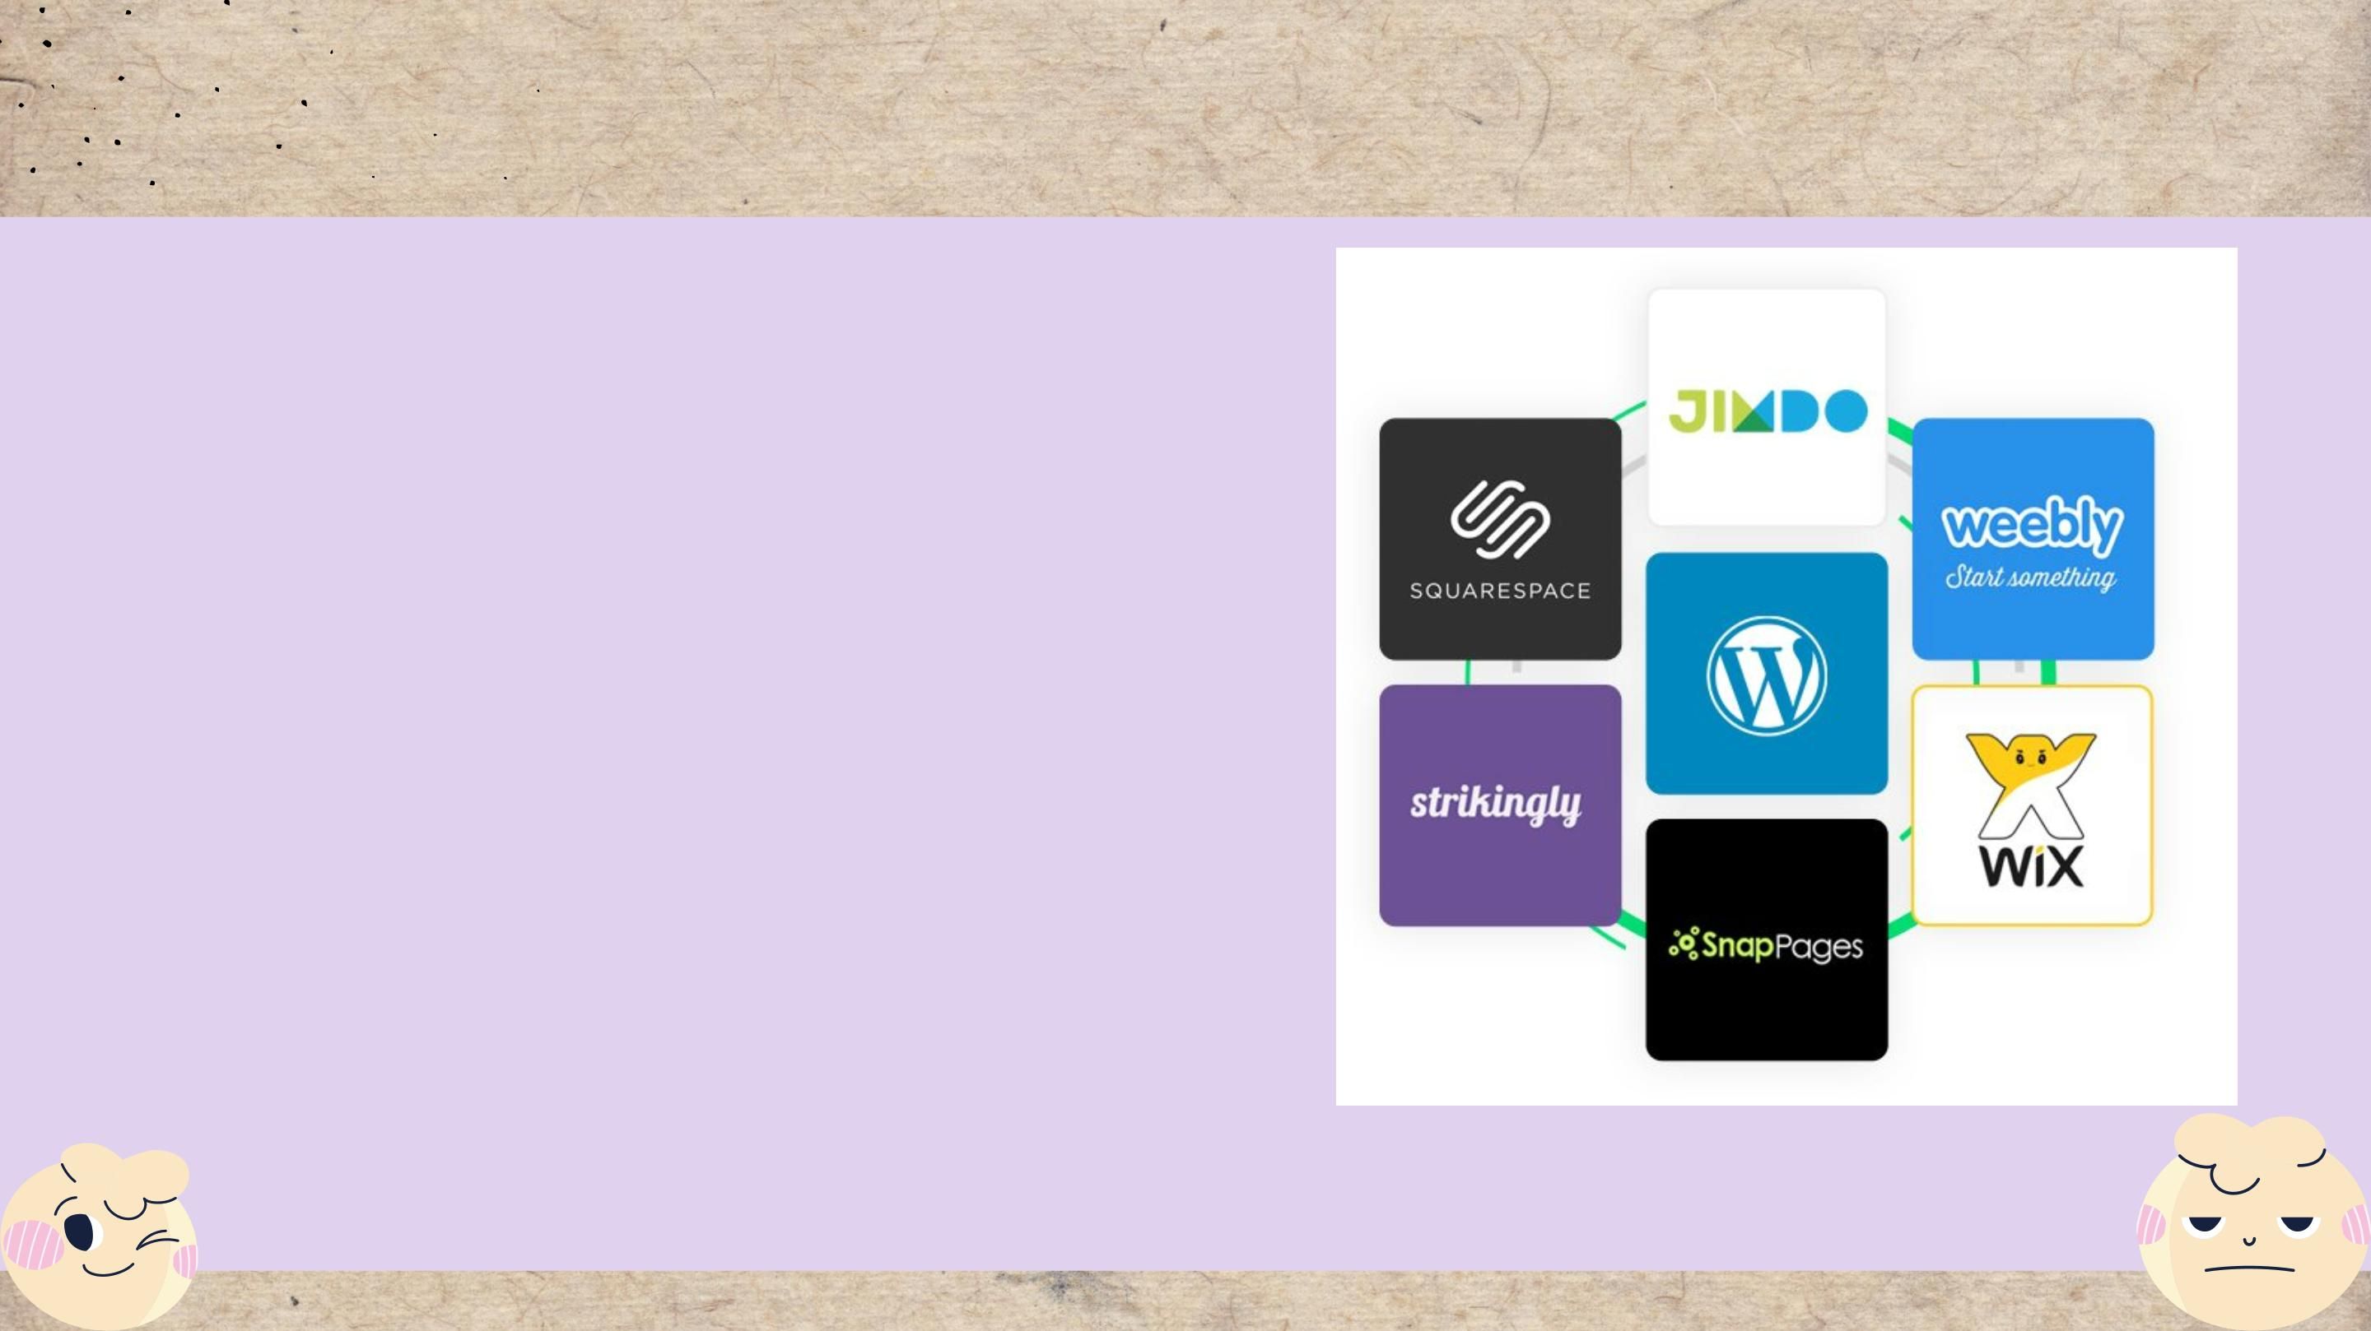
Website Builders Technologies
Some website builders :
• Wix
• Squarespace
• Weebly
• Duda
••••

Slide 30
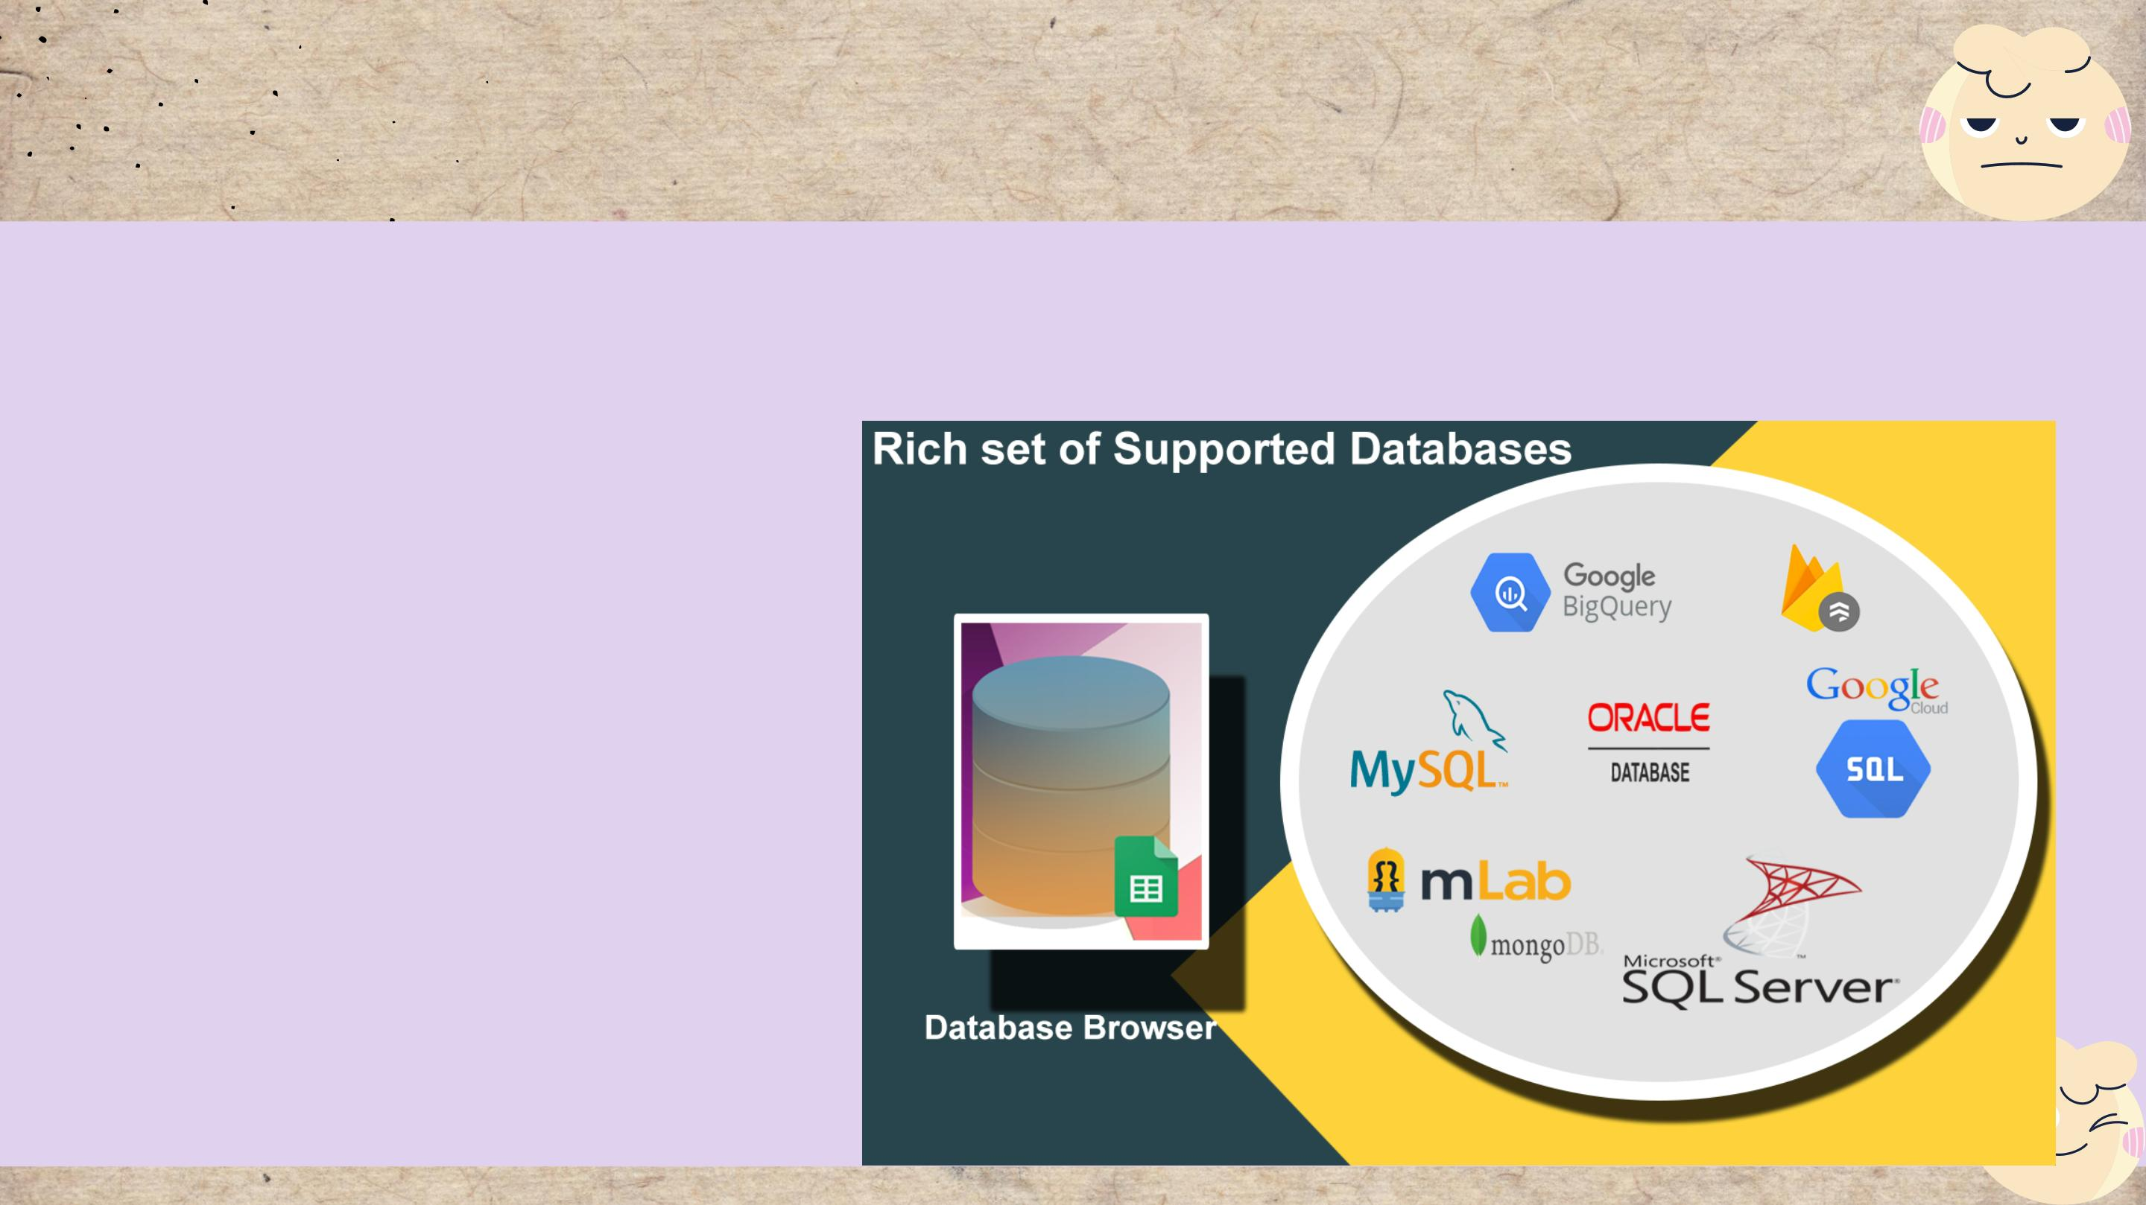
Databases
Some Databases technologies use:
• Microsoft SQL Server
• PostgreSQL
• MySQL

Slide 31
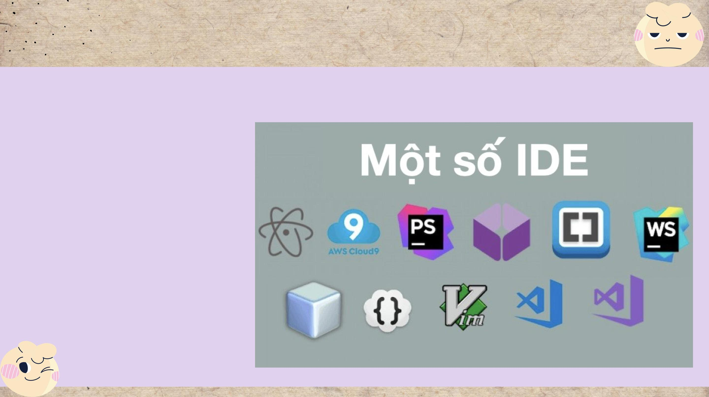
IDEs technologies
Some IDE technologies use:
• Visual Studio Code
• IntelliJ IDEA
• Sublime Text
• Xcode
• WebStorm

Slide 32

References
Bill, G., 2021. 26+ Top Web Server Software Free for Windows, Linux. [Online]
Available at: https://freshdesignweb.com/web-server-software-free/
Cloudflare, 2022. DNS server types. [Online]
Available at: https://www.cloudflare.com/learning/dns/dns-server-
types/#:~:text=What%20are%20the%20different%20types,TLD%20nameservers%2C%20and%20authoritative%20nameserve
Dealna, 2022. Three Types of Server Hardware. [Online]
Available at: https://dealna.com/en/Article/Post/1391/Three-Types-of-Server-Hardware
Developer, 2022. An overview of HTTP. [Online]
Available at: https://developer.mozilla.org/en-US/docs/Web/HTTP/Overview
Developer, 2022. How the Web works. [Online]
Available at: https://developer.mozilla.org/en-US/docs/Learn/Getting_started_with_the_web/How_the_Web_works#clients_and_servers
Fortinet, 2022. What is a Transmission Control Protocol TCP/IP Model?. [Online]
Available at: https://www.fortinet.com/resources/cyberglossary/tcp-ip
Javatpoint, 2021. What is World Wide Web?. [Online]
Available at: https://www.javatpoint.com/what-is-world-wide-web
Max, D., 2020. Choose Best Web Server from a Number of Open Source Web Servers. [Online]
Available at: https://www.temok.com/blog/choose-best-web-server-from-a-number-of-open-source-web-servers/
Networkstraining, 2022. DNS Port Number – What is Domain Name System – How DNS Works. [Online]
Available at: https://www.networkstraining.com/what-is-dns/
Ns1, 2022. DNS: Types of DNS Records, DNS Servers and DNS Query Types. [Online]
Available at: https://ns1.com/resources/dns-types-records-servers-and-queries
springwk_wp, 2015. The Various Differences Between The Static And The Dynamic Web Pages And Websites. [Online]
Available at: https://www.springworks.biz/2015/11/24/static-and-dynamic-website/
Trego, M., 2016. Front-end & Back-end Web Development: Your Ultimate Guide. [Online]
Available at: https://blog.stoneriverelearning.com/front-vs-back-end-web-development-your-ultimate-guide/

Slide 33

Ngày 25 tháng 7 năm 2022

